Slide 1
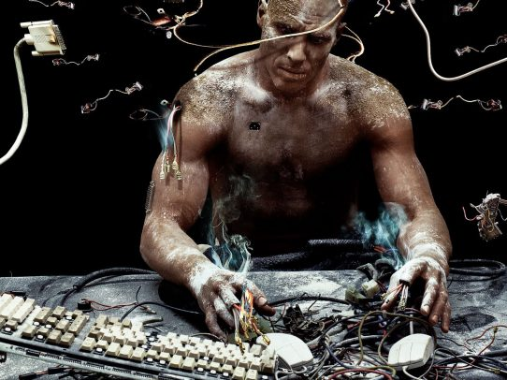
Vulnerable cyborgs reloaded
From narrative technologies for self-shaping to vulnerability transformations in modernity and the Anthropocene
Mark Coeckelbergh
Professor of Philosophy of Media and Technology
University of Vienna, Austria
mark.coeckelbergh@univie.ac.at

Slide 2
introduction

Slide 3

vulnerability and risk
As soon as we are born, and even before we are born, we are vulnerable: we are dependent on many people and things, and many kinds of bad things can happen to us
  always but often we are not aware of it; we become aware of it through specific (risk and vulnerability) experiences

Slide 4
technology and vulnerability
A strange combination?
  The digital as escape from vulnerable material and bodily existence
  Vulnerable humans versus technology
    Günter Anders The Outdatedness of Human Beings/ Die Antiquiertheit des Menschen (1956): Promethean shame: we realize that the things we make are less vulnerable than us

Slide 5
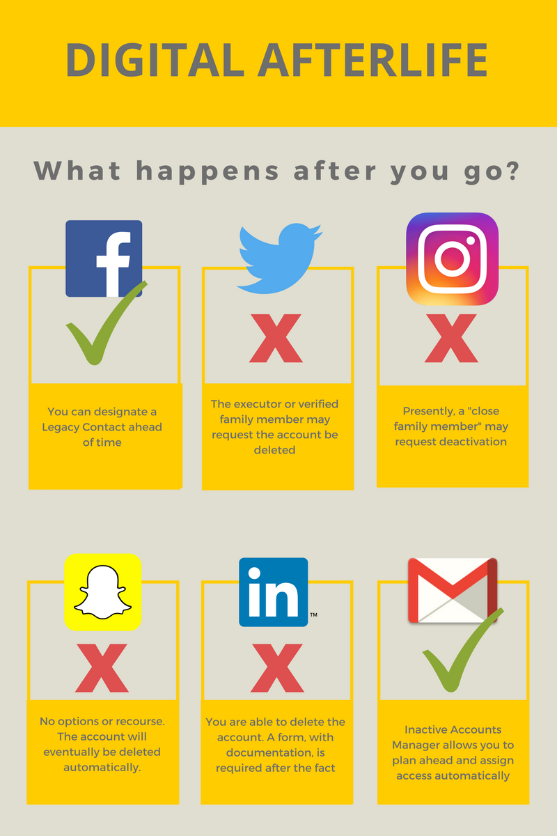
narrative technologies
Using technology to cope with vulnerability
  E.g. mourning, coping with disease, etc.
Performing the self on social media (José van Dijck) is itself not without risks
Stronger link between tech and our narratives
  Narrative technologies (Rijers & Coeckelbergh)

Slide 6
beyond
New technologies and media
are not only tools and mediators that influence how we cope with vulnerability
they also shape and transform our existential vulnerability

Slide 7
Analysis of vulnerability needed
Use of technology to deal with vulnerability or impact of technology on vulnerable people versus analysis of existential vulnerability
Vulnerability as existential condition of the human
Then consider the role of technology

Slide 8
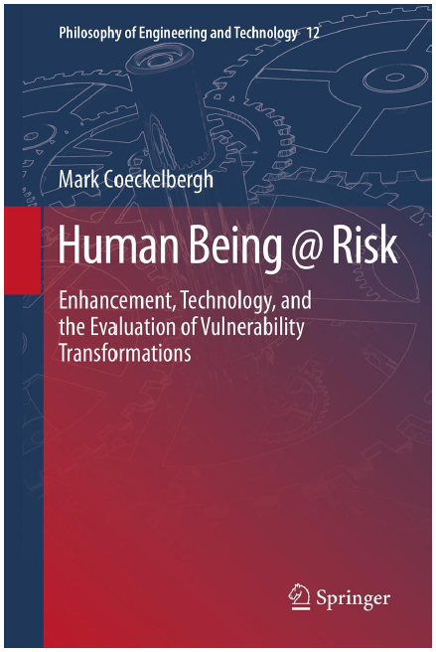
Human Being @ Risk (2013)
Starts from phenomenology of being-vulnerable and being-at-risk
Then considers role of technology

Slide 9
Phenomenology of being-vulnerable and technology

Slide 10
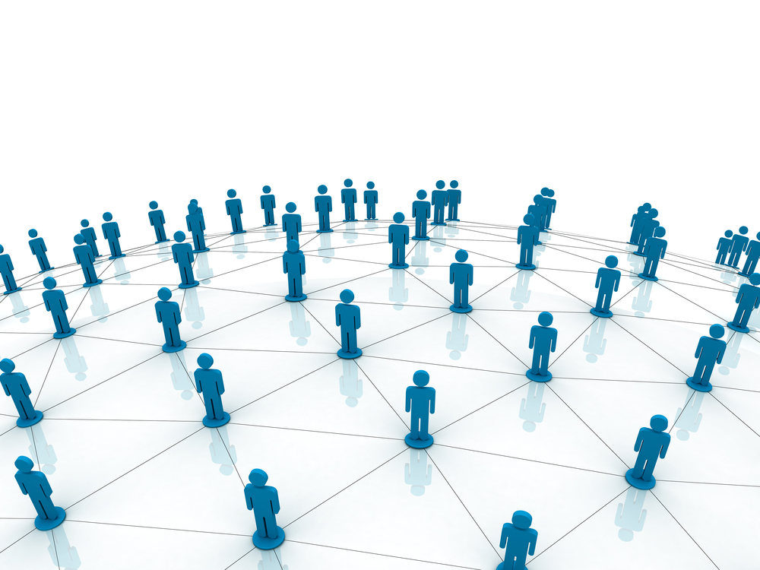
1 || Being-vulnerable
Human vulnerability is
always experienced, lived vulnerability
relational
  others
  (see also
    Butler)
  Objects
feelings
  fear, terror
    (Heidegger)
    subject – object: I am what I fear

Slide 11
2 || Being-vulnerable
Vulnerability not only passive but
also active and practical: putting-at-risk

Slide 12

3 || Being-vulnerable
Being-vulnerable not merely individual matter
Cultures shape how we put ourselves at risk and how we experience vulnerability
  Existers (Lagerkvist)?
  Thrown back
  on ourselves?
  Yes and no:
  cultures
  provide
  support;
  there are
  patterns,
  narratives etc
  available + I am not born alone

Slide 13
4 || Being-vulnerable
Vulnerability is not exclusively bad or problematic
Relations of vulnerability, risk and dependency are
  the very conditions for what is good and valuable to arise
  necessary for survival

Slide 14
5 || Technology
Technology has a dual role
“Anti-vulnerability tool,” aiming to render us less dependent, less vulnerable
At the same time: new vulnerabilities, dependencies and risks
  Transformation of personal, societal and human vulnerability

Slide 15
6 || Technology
Technology’s dual role is often forgotten or suppressed
when the hope is that modern technology can significantly mitigate or eradicate human vulnerability
  See for example some versions of transhumanism

Slide 16

7 || Technology / Being-vulnerable
Being human today crucially depends on
the new vulnerabilities created by the new technologies

Slide 17
8 || Technology / Being-vulnerable
Human being has always been intimately connected with technology
There is a continuous vulnerability/ risk struggle
  at a personal level
  at the level of society and cultures
  at the level of humanity at large

Slide 18
9 || Technology / Being-vulnerable
There is no way to end this struggle
How do we want to be at risk?
What kind of humans do we want to be?
What kind of technologies do we want?

Slide 19
10 || Technology / Being-vulnerable
In order to begin to answer these questions,
we have to move to the analysis of specific technologies
a key term is connectivity, which is based on (technological) infrastructures
do not distinguish between lifeworld and technological world, both are merged
  See also Floridi: onlife

Slide 20
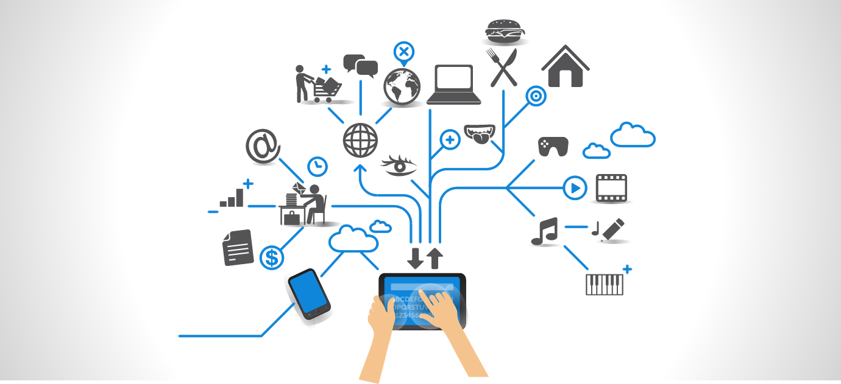
Connection and disconnection

Slide 21
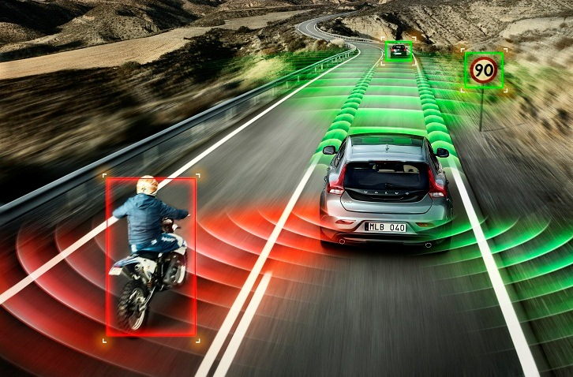
when your life depends on IT

Slide 22

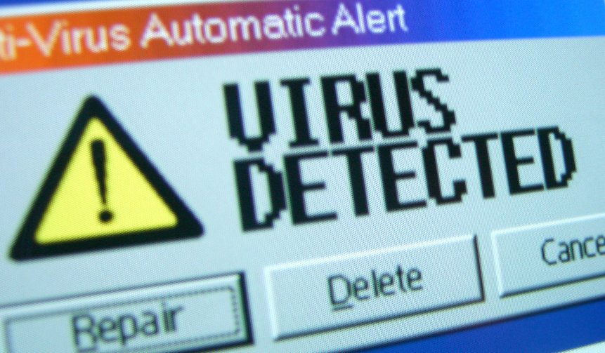
A computer virus is my virus

Slide 23
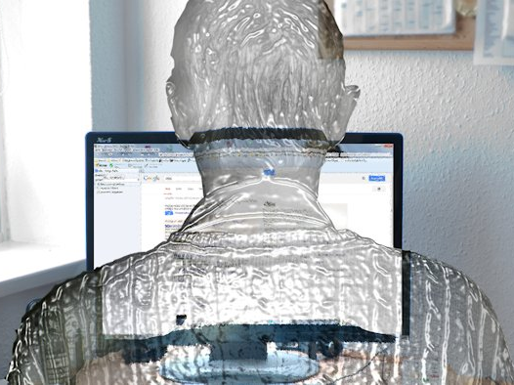










Google‘s security is my security

Slide 24
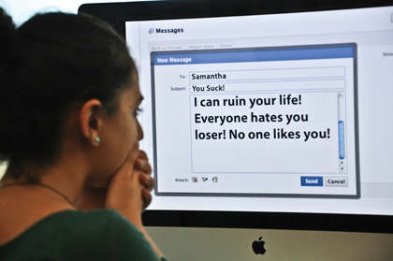
Social media: bullying, trolling

Slide 25
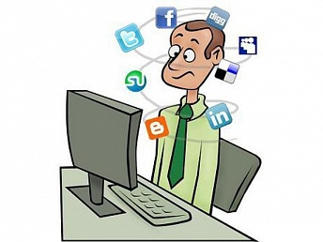
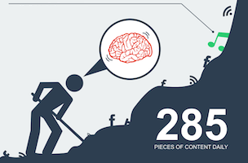
Social media: information overload

Slide 26

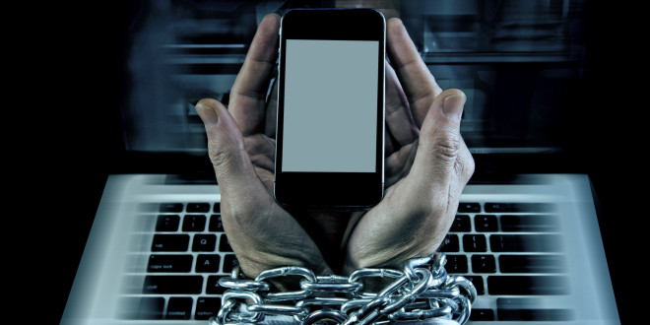
Social media: addiction

Slide 27
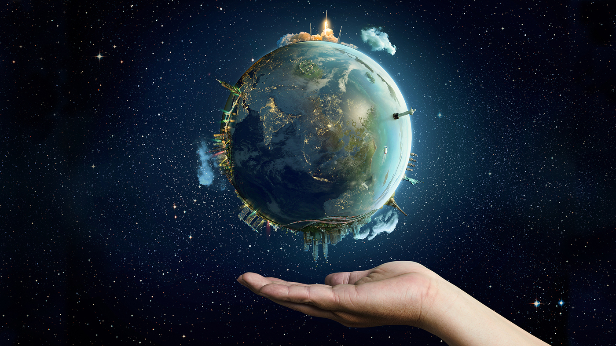
11 || Technology / Being-vulnerable
Vulnerability must be understood in a relational and holistic way
The future of nature and the future of the human and the technological can no longer be disentangled (see also: anthropocene)

Slide 28
12 || Technology / Being-vulnerable
The intimate connections between
the technologies and the systems, and
the lived experiences, lifeworlds, and practices of vulnerability
  Note: includes (em)body(ment): we remain embodied! (see Human Being @ Risk and see Charles Ess)
need to be made visible and critically discussed
humanities + social sciences + tech + …

Slide 29
13 || Technology / Being-vulnerable
How do we currently cope with our vulnerability through technology and media?
Not against or without technology, but with technology

Slide 30
conclusion

Slide 31
conclusion
First a note about speaking about “we”:
  “we” is humanity but can also mean specific socities, (sub)cultures, people, it can mean you, I, so to talk about the human does not necessarily exclude sensitivity to difference, power questions, etc.
  Generalization in order to talk about anthropocene condition fine, as long as we remain aware that it is a generalization and also have other types of analysis and criticism

Slide 32
conclusion
We cannot change vulnerability as existential condition, but we can change HOW we are vulnerable
Develop different technologies in order to re-configure our dependencies, vulnerabilities, and risks
Which ones? Imagine and experiment

Slide 33
conclusion
Try to hack how we are vulnerable, and resist dependencies that lead to vulnerabilities we do not want
We cannot extinguish vulnerability, since that would be to extinguish human being

Slide 34
Thank you!
Mark Coeckelbergh
Professor of Philosophy of Media and Technology
University of Vienna, Austria
mark.coeckelbergh@univie.ac.at

